Slide 1


Slide 2
Content
1
Concurrent computing
2
Advantages
1
Performance
2
Resource utilization
3
Latency decreasing
3
Wonders
1
Races
2
Complexity
3
Tech issues
4
Conclusion

Slide 3

Inspiration

Slide 4
Concurrent computing is a form of computing in which several computations are executed during overlapping time periods—concurrently—instead of sequentially (one completing before the next starts)
Definition

Slide 5
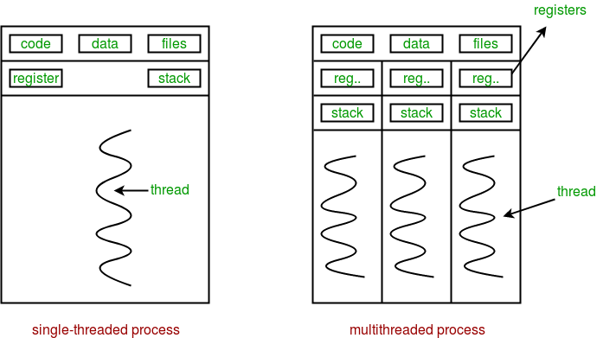
Sequential vs concurrent

Slide 6
Performance

Slide 7
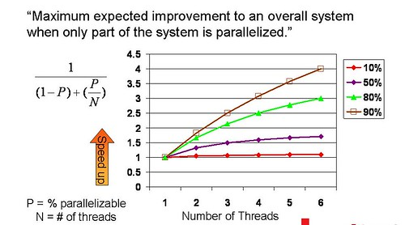
Amdahl's law

Slide 8
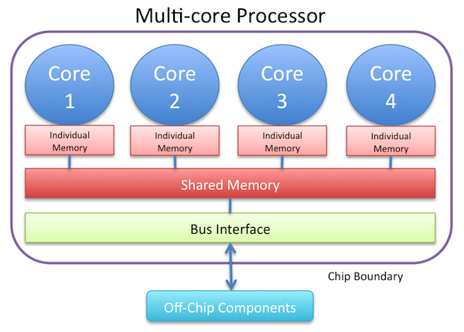
Resource utilization

Slide 9
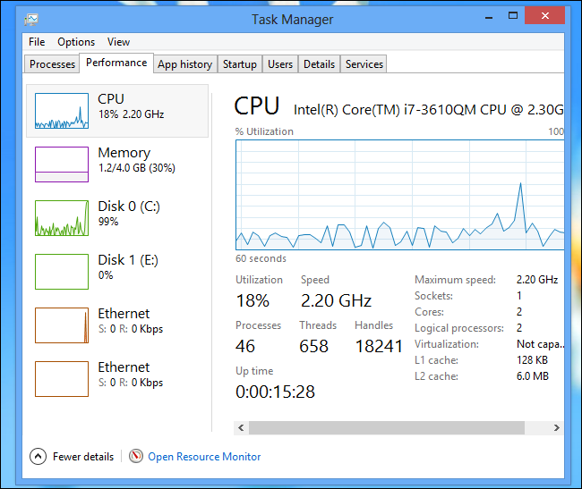
Resource utilization

Slide 10
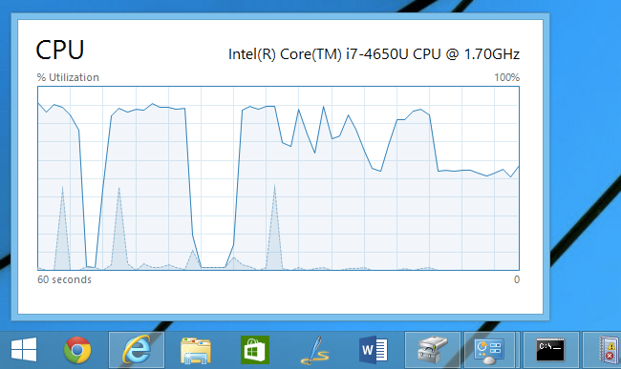
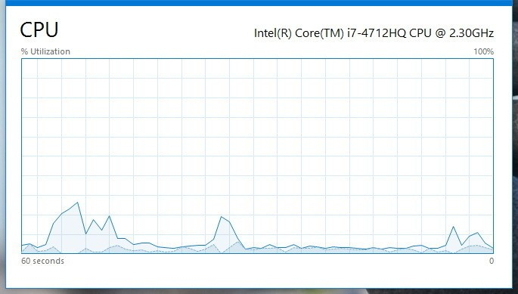
Resource utilization

Slide 11
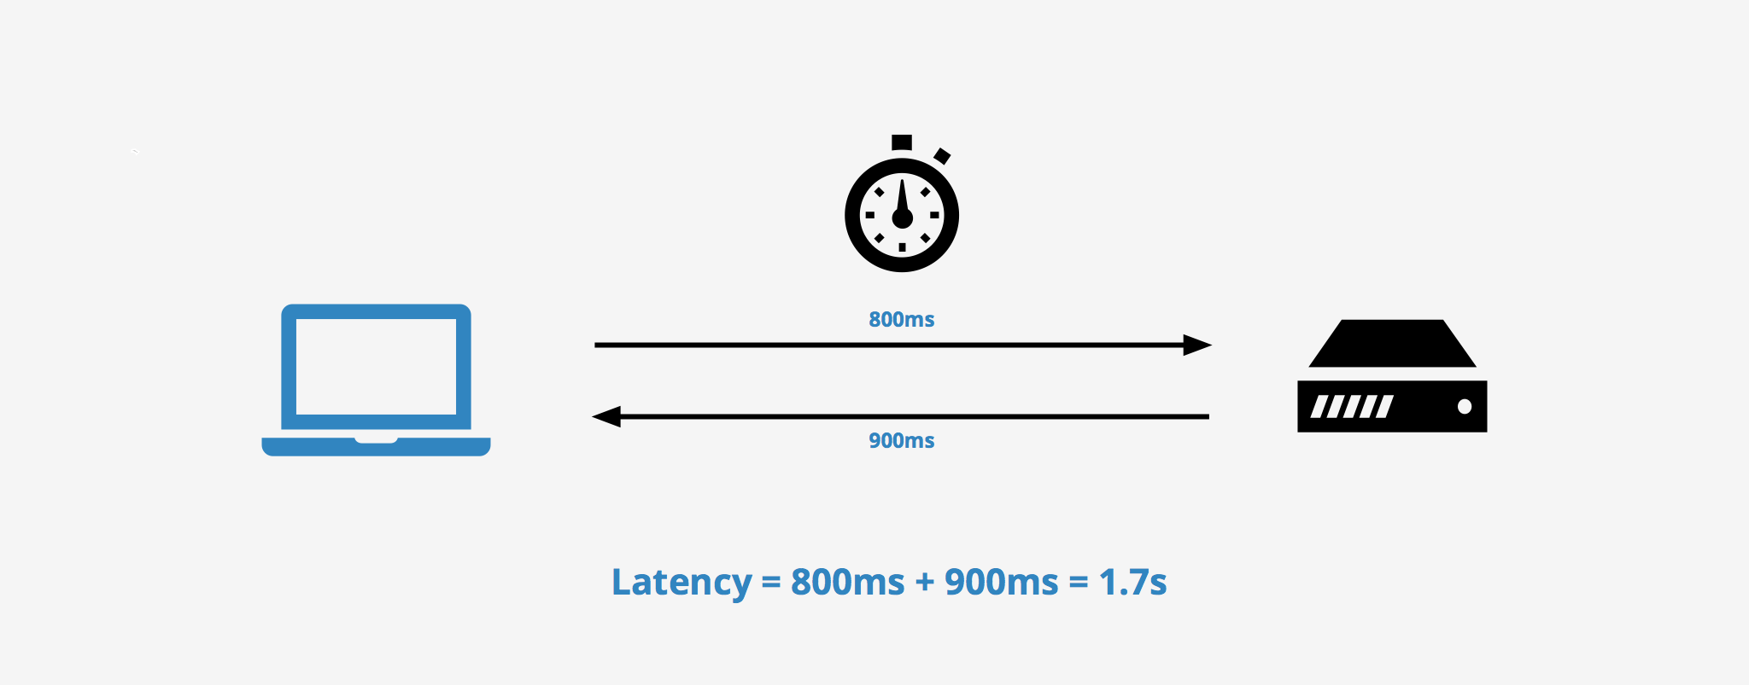
Latency

Slide 12

Modern way

Slide 13
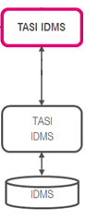
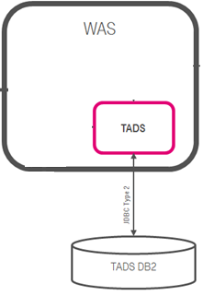
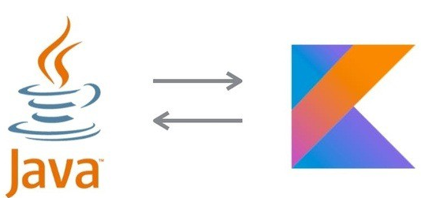
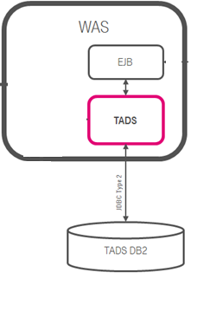
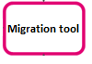

Concurrent Dijkstra algorithm

Slide 14
Multi thread migration

Slide 15
Single thread migration
7h21 min 1.7 r/s

Slide 16
Multi thread migration

Slide 17
Multi thread migration
7h21 min 1.7 r/s
28 min 23 r/s

Slide 18

The show begins

Slide 19
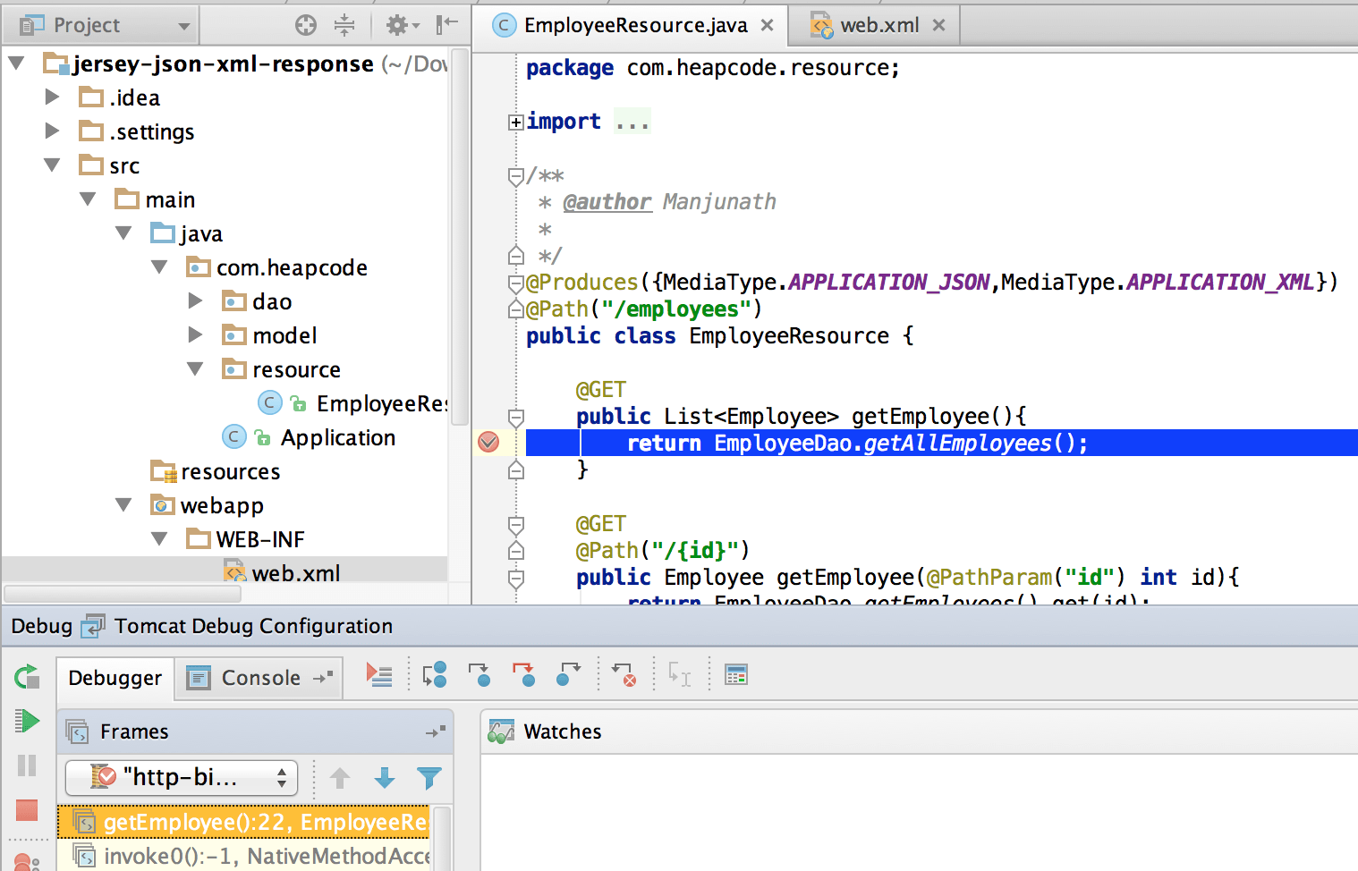
#1 Difficult to debug

Slide 20
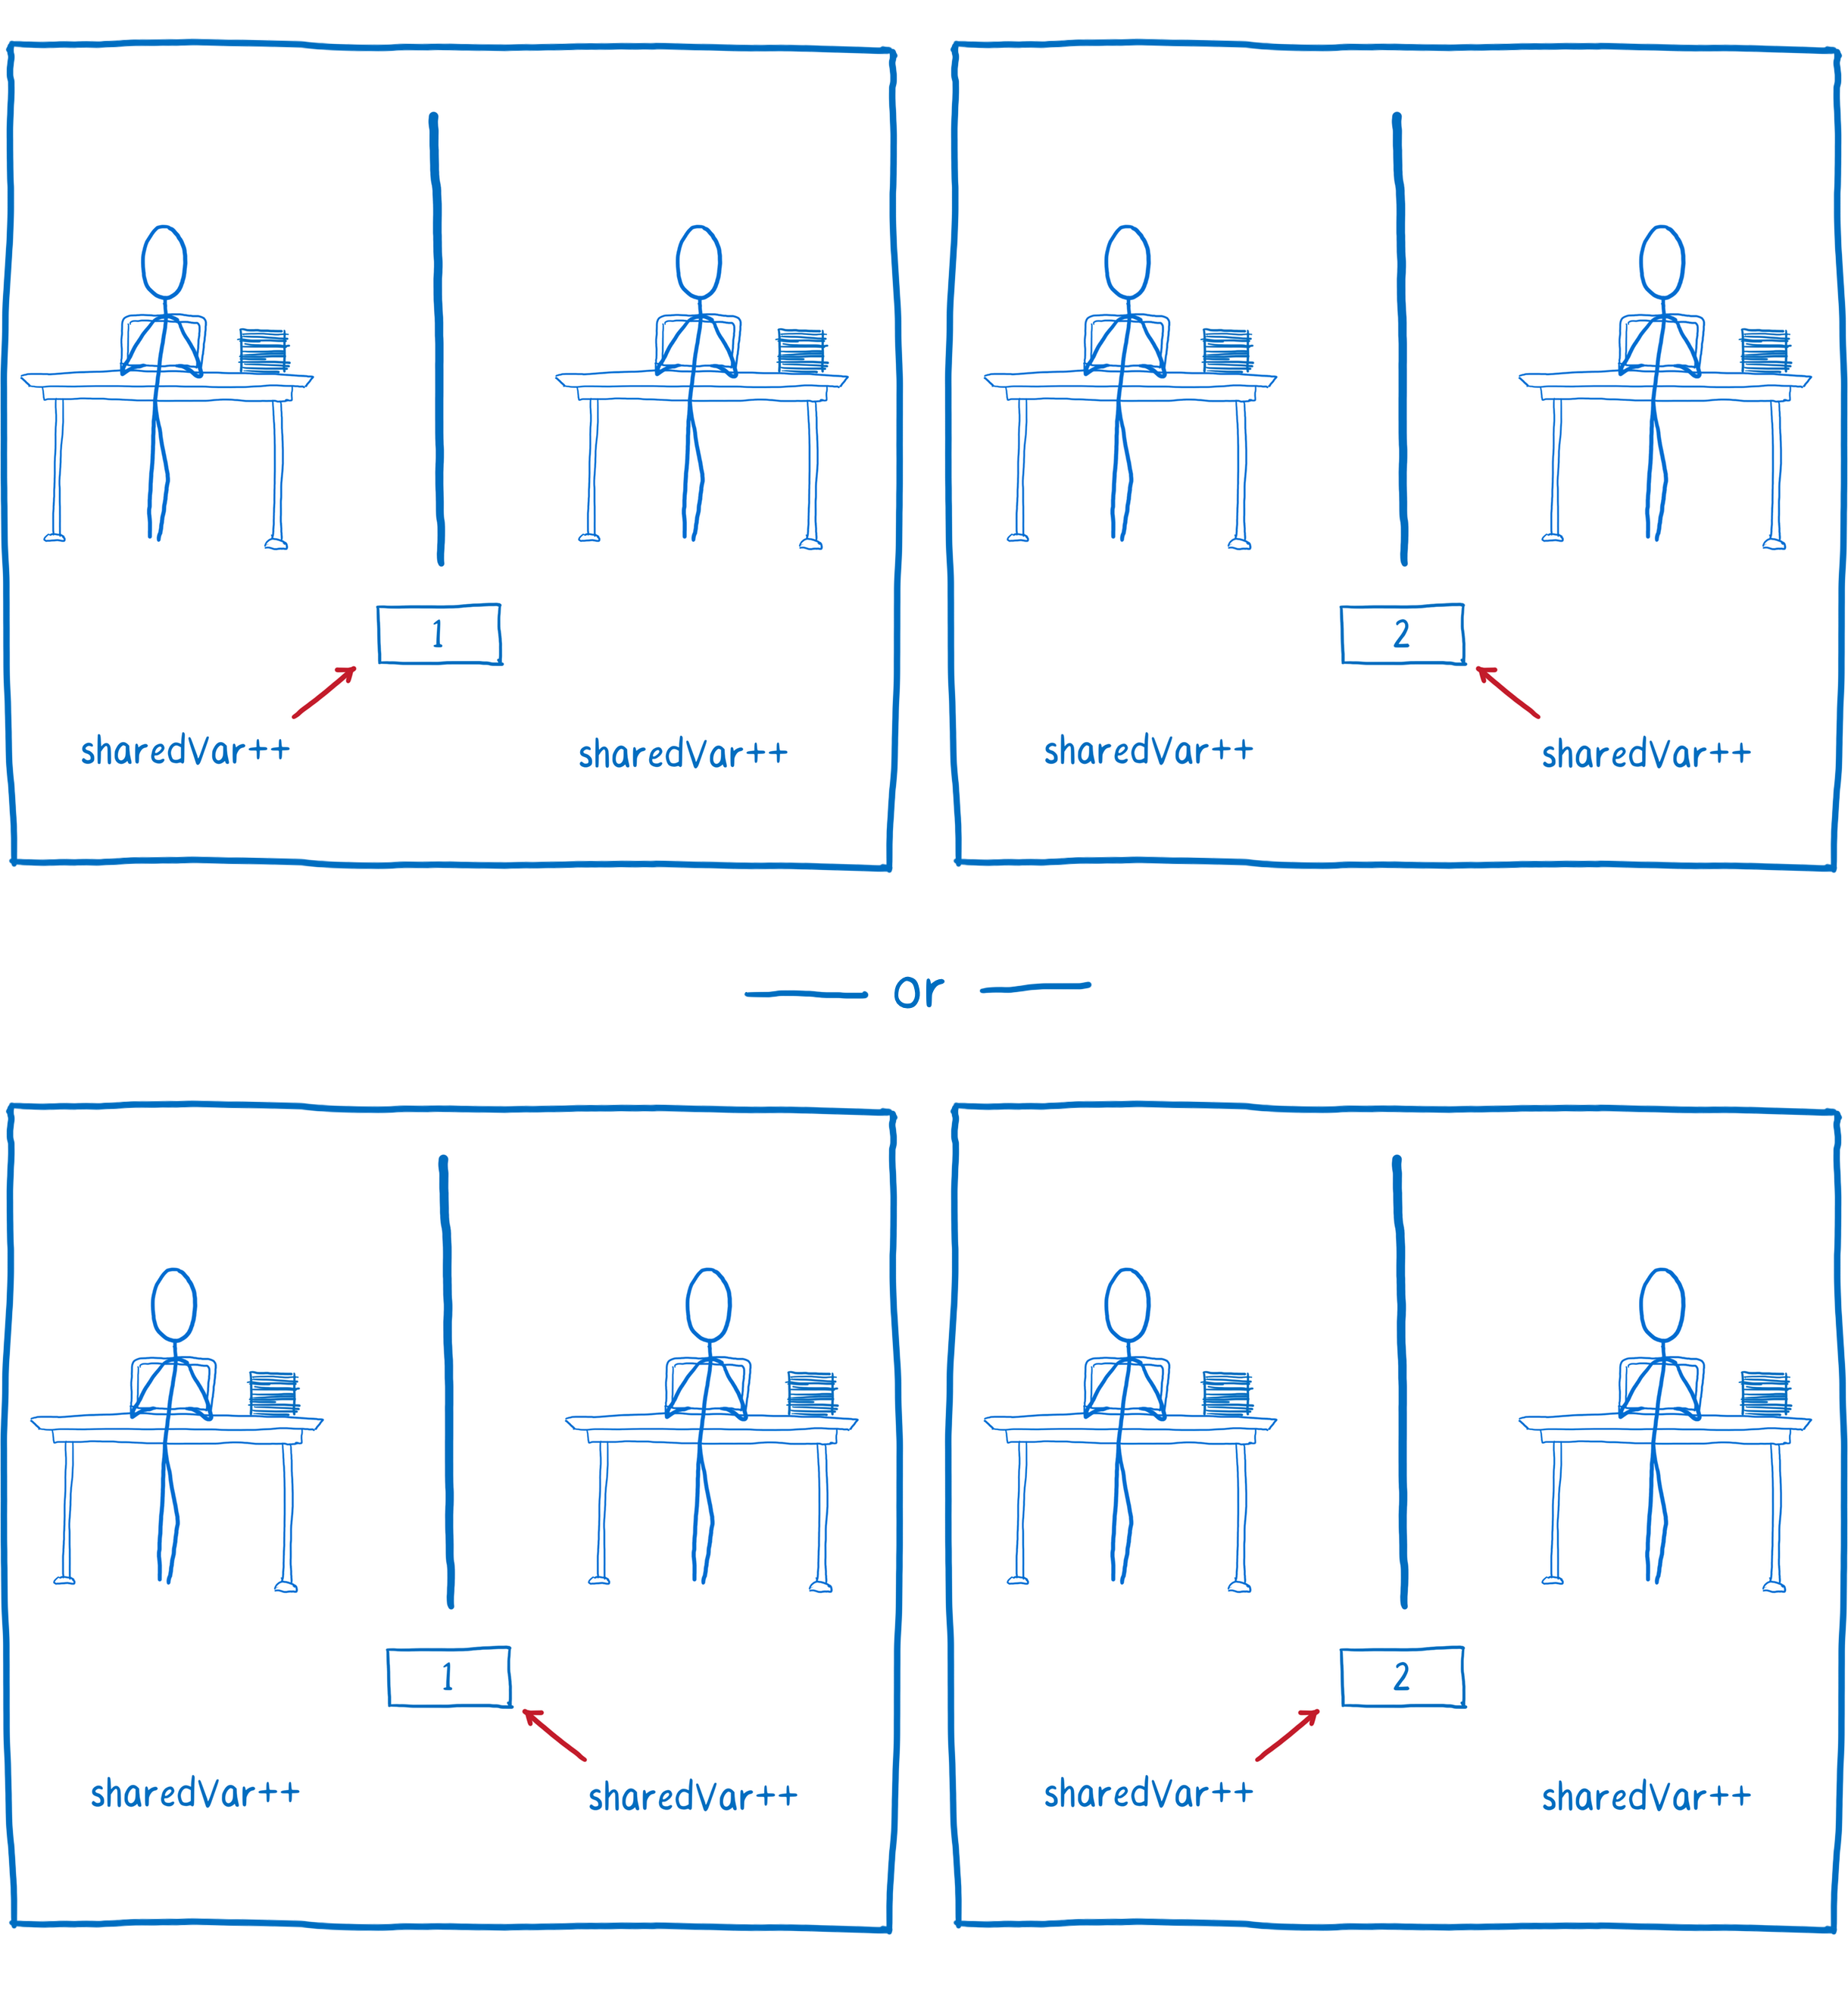
#2 Race condition

Slide 21
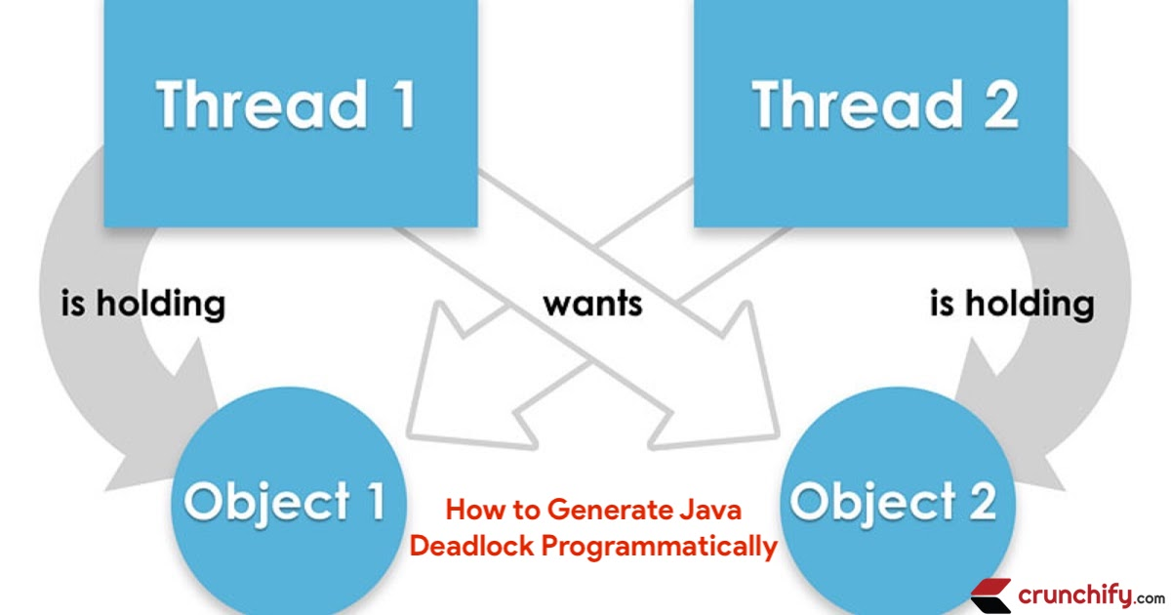
#3 Dead locks

Slide 22
Concurrency mad stuff
“But I don’t want to go among mad people," Alice remarked. - "Oh, you can’t help that," said the Cat: "we’re all mad here. I’m mad. You’re mad." - "How do you know I’m mad?" said Alice. - "You must be," said the Cat, "or you wouldn’t have come here.”
Alice's Adventures in
Wonderland by Lewis Carroll

Slide 23
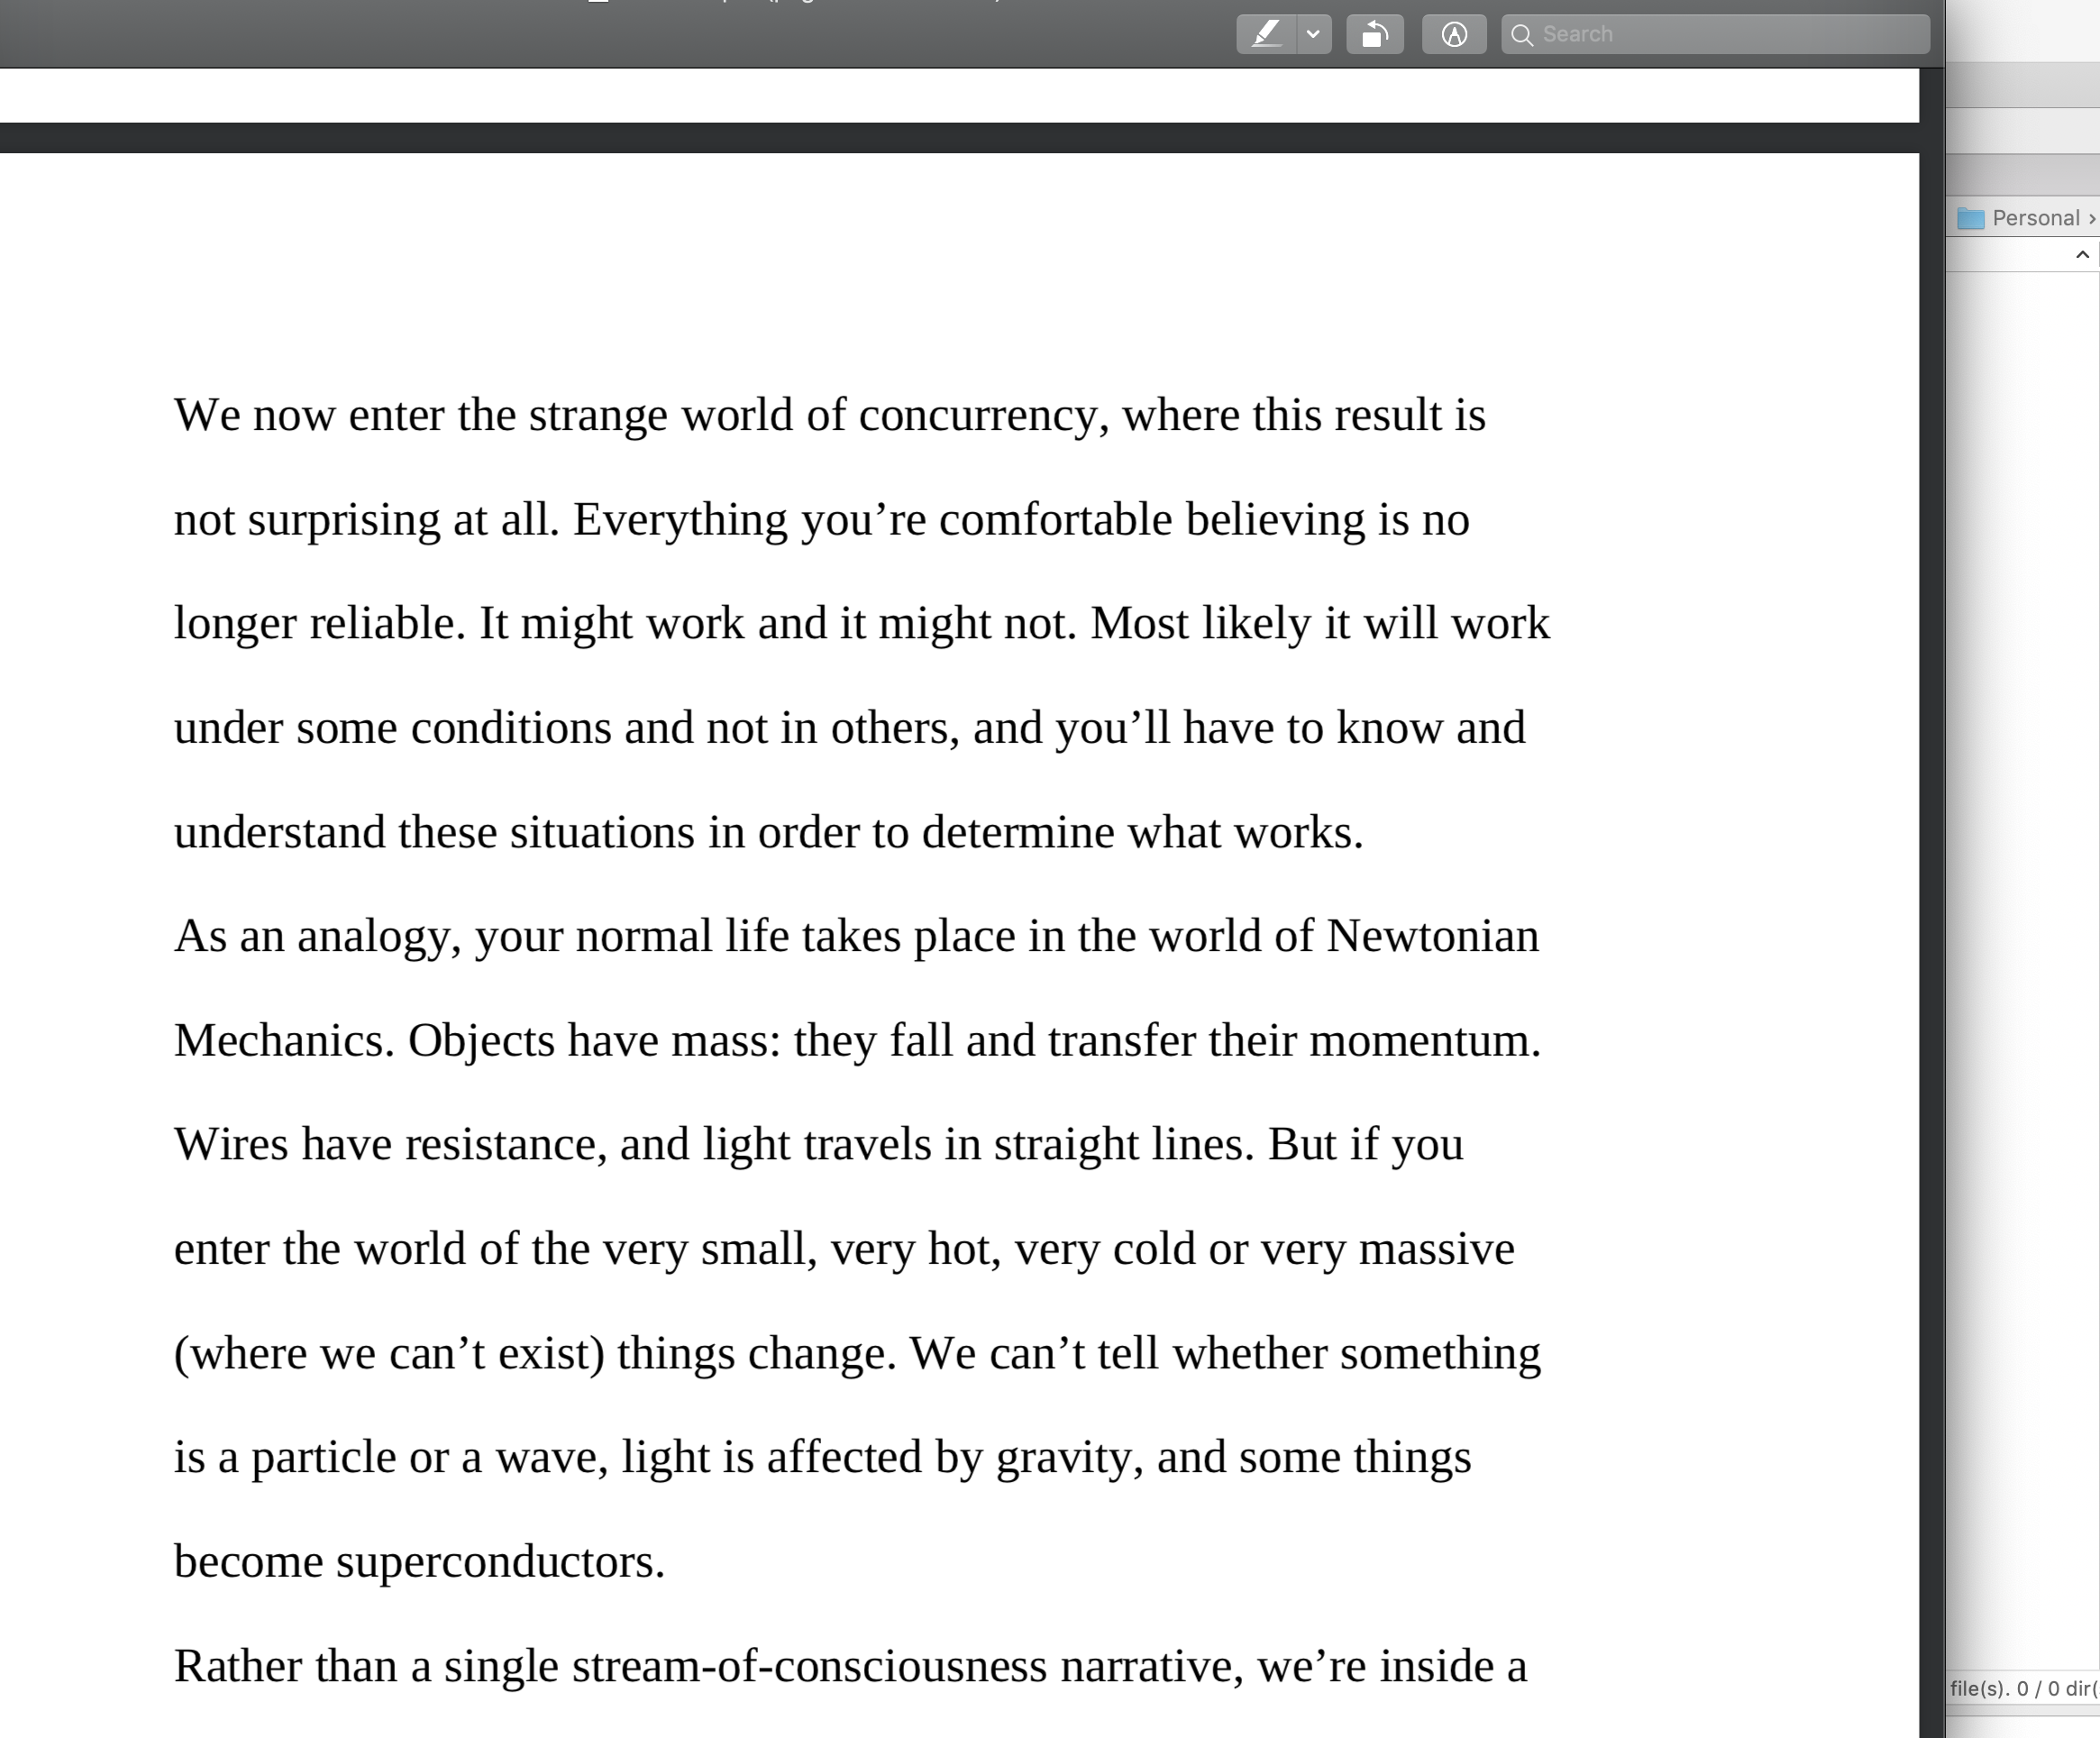

Dev practices
On Java 8 by Bruce Eckel

Slide 24
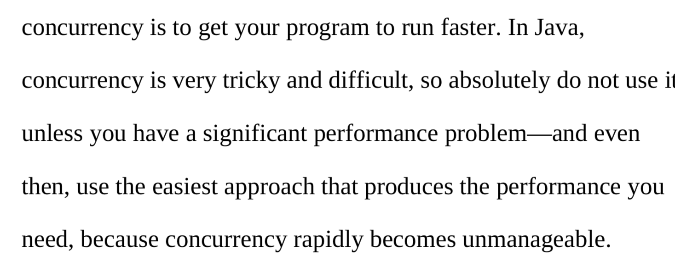

Dev practices
On Java 8 by Bruce Eckel

Slide 25
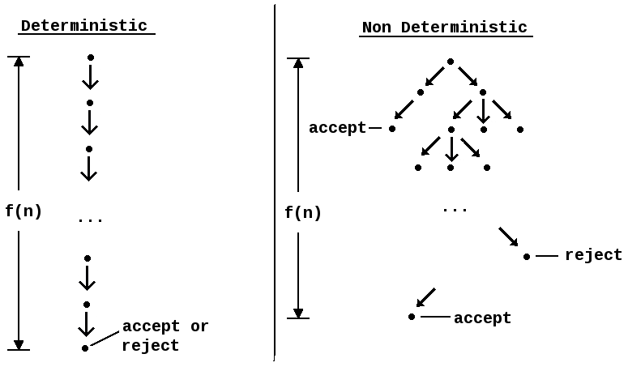
#4 Non deterministic behavior

Slide 26
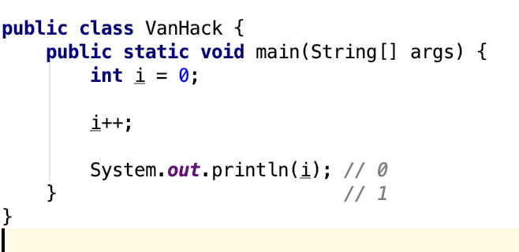
#4 Non deterministic behavior

Slide 27
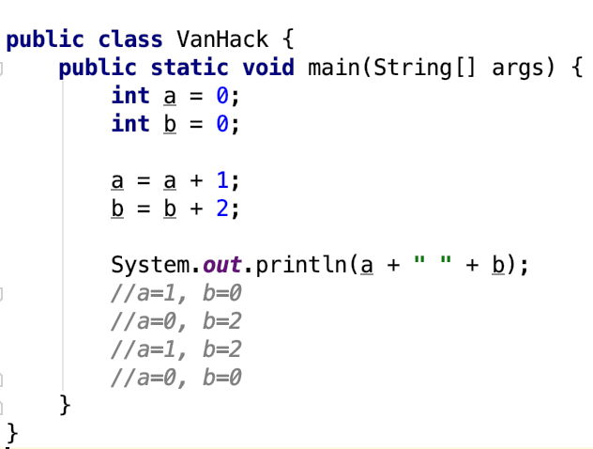
#4 Non deterministic behavior

Slide 28
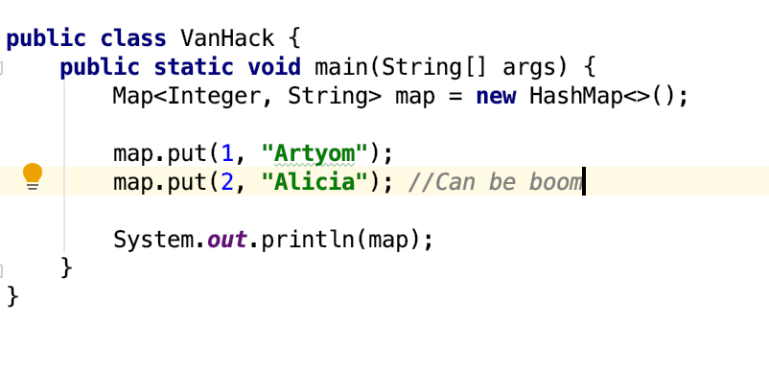
#4 Non deterministic behavior

Slide 29
Are you still here?
Twas brillig, and the slithy toves Did gyre and gimble in the wabe: All mimsy were the borogoves, And the mome raths outgrabe
Jabberwocky by Lewis Carroll

Slide 30

Let’s continue?

Slide 31
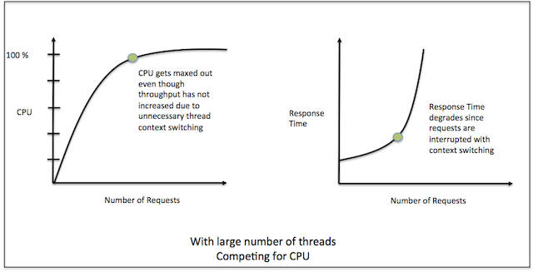
#5 Performance degradation

Slide 32
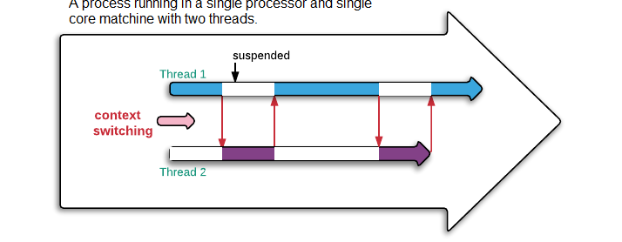
#5 Performance degradation

Slide 33
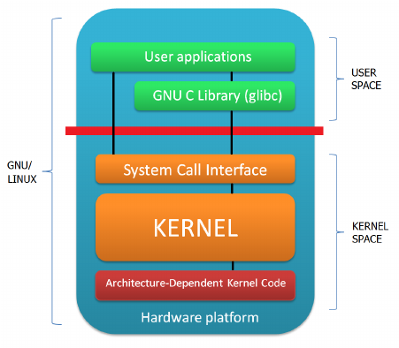
#6 OS limitation

Slide 34

Stop it? Hell no…

Slide 35

#7 Hardware unpredictable optimizations

Slide 36
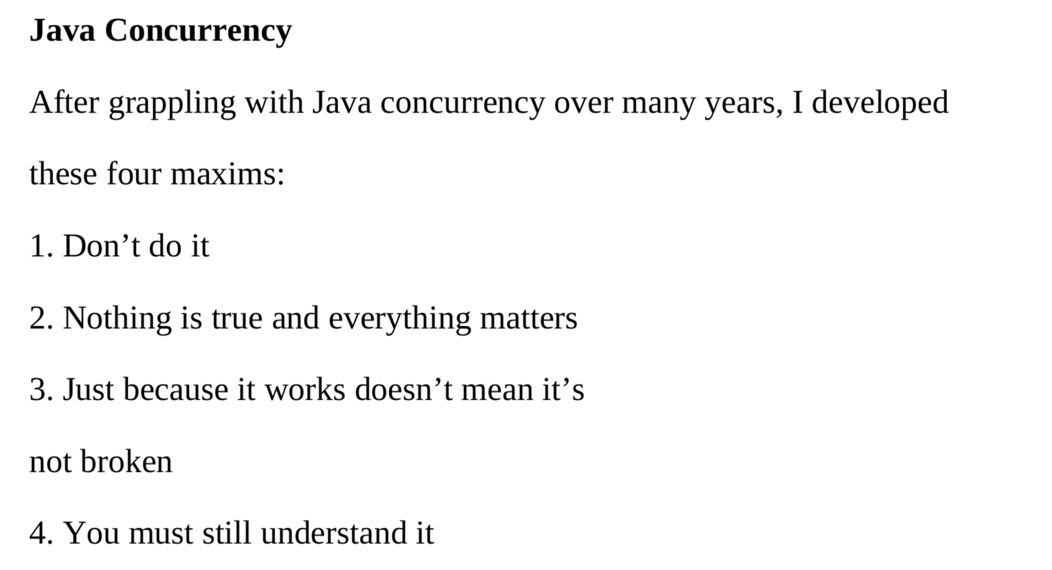
Concurrency in real world
On Java 8 by Bruce Eckel

Slide 37
Conclusion
Concurrency is powerful practice, you can achieve a lot using it
Don’t use concurrency if you can avoid it
Use best practices by experts
Use frameworks with big professional community
Minimize synchronization and data sharing
Perform load and stress testing
Use as much as possible existed solutions
Don’t forget about mad world and wonders

Slide 38
Resources
Java concurrency in practice (Brian Goetz )
On Java 8 (Bruce Eckel)
The Art of Multiprocessor Programming (Maurice Herlihy , Nir Shavit )

Slide 39

THANK YOU!
artyom-karnov@yandex.ru, Saint-Petersburg, 2019

